Slide 1
Summer project
SQL part

Slide 2
Summer project
Check word document for detailed description

Slide 3
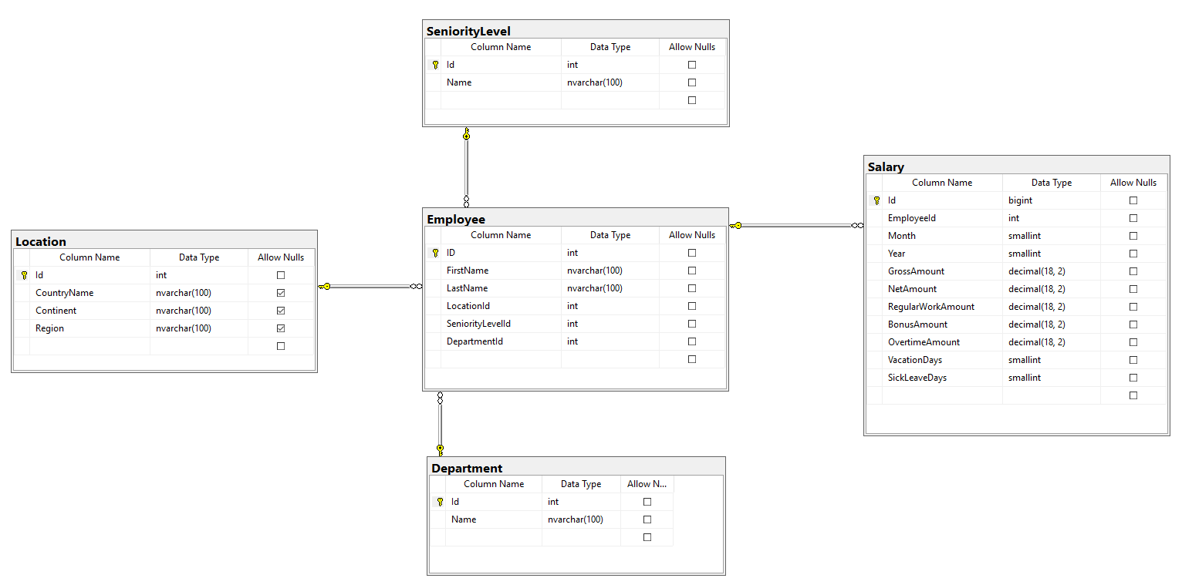
Summer project – diagram

